Slide 1

Day 3: Object-Oriented Programming & File Handling (Python)
Clear, practical guidance for beginner → intermediate Python programmers. Today we pair OOP fundamentals with file and data workflows you'll use in web and data tasks.

Slide 2
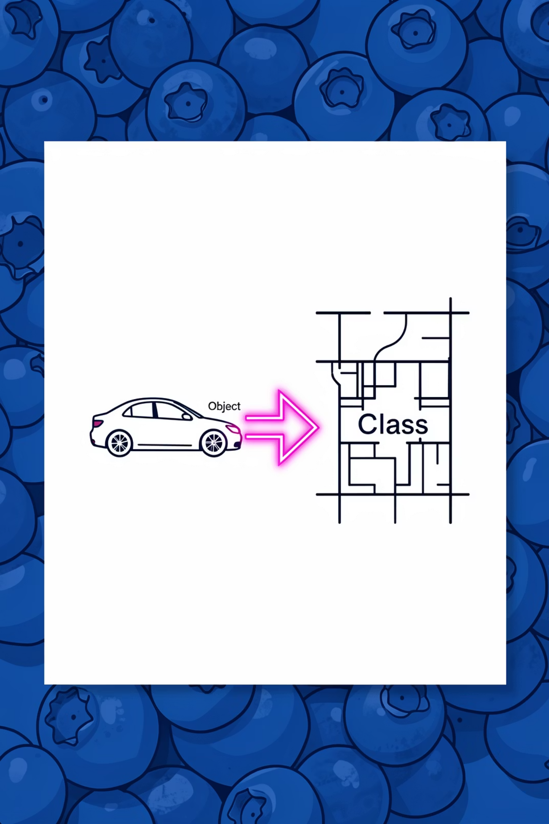

What is Object-Oriented Programming (OOP)?
OOP models programs as collections of objects—bundles of data and behavior. It helps organize code, make it reusable, and map real-world concepts to software.
Why use OOP?
When to choose OOP
Improves modularity, readability, and reuse for medium-to-large projects.
Use when modeling entities with state and behavior: users, items, sessions.

Slide 3
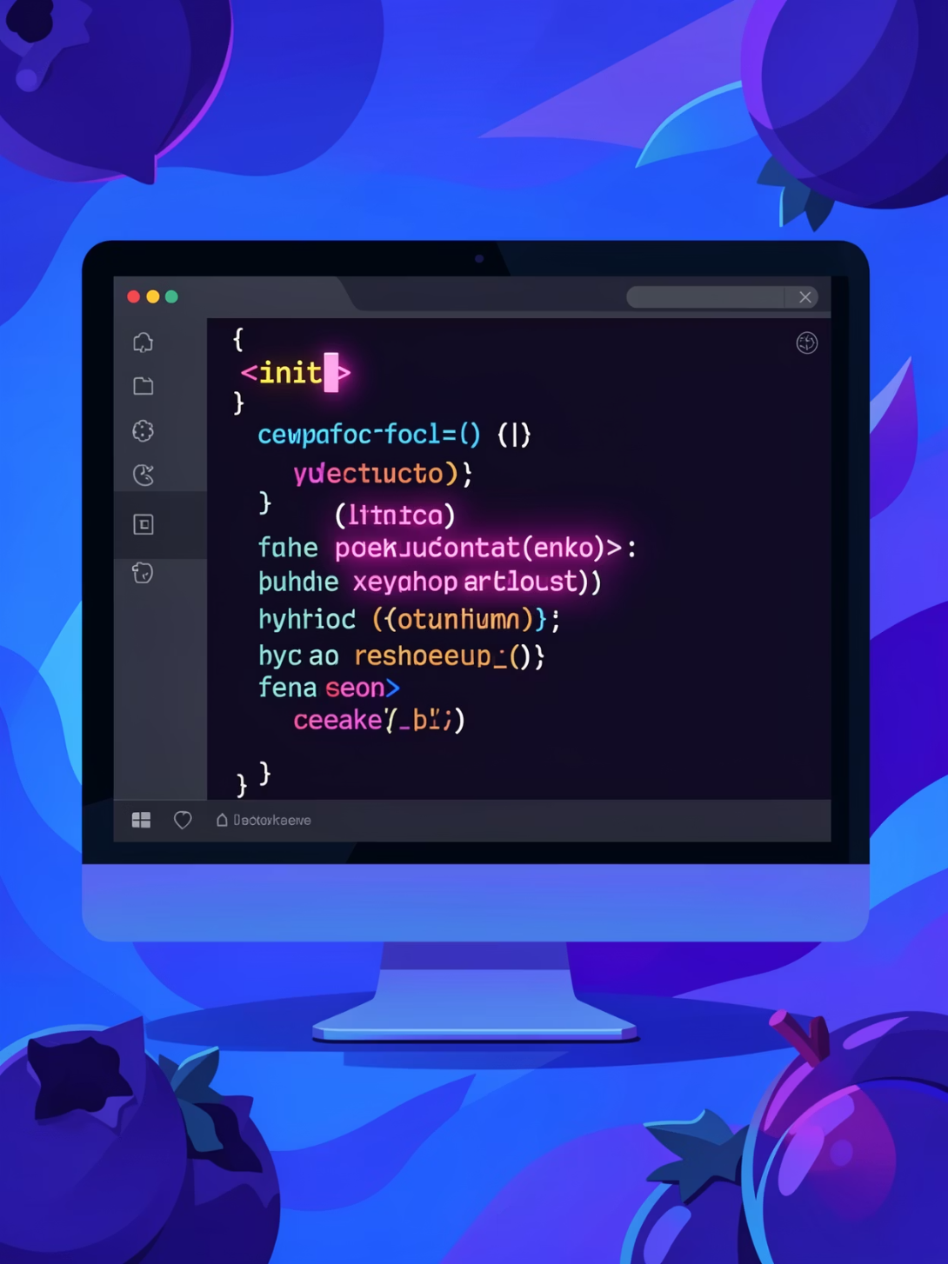
Classes, Objects, and Constructors
Class = blueprint. Object = instance of a class. Use def __init__(self, ...): to initialize attributes for each instance. The self parameter gives each object access to its own data and methods.
Define attributes in __init__
Call methods with self.method()
Create instances: obj = MyClass(args)

Slide 4


Core OOP Concepts
Encapsulation
Inheritance
Bundle data and methods; use private attributes (prefix with _) to suggest internal state.
Create a subclass to reuse and extend behavior (single inheritance example).
Polymorphism
Class & Static Methods
Override methods to change behavior while keeping the same interface.
@classmethod receives class (cls); @staticmethod has no implicit first arg.

Slide 5


Inheritance & Method Overriding — Quick Example
Subclassing lets you extend a base class. Method overriding replaces a parent method with a child implementation. Keep interfaces consistent so code using the base class works with subclasses.
Tip: Use super() to call parent behavior when extending methods.

Slide 6

File Handling Basics
Files are primary I/O for web and data tasks. Use built-in functions to open, read, and write files safely.
Modes: 'r', 'w', 'a', 'r+'
Read: read(), readline(), readlines()
Write: write(), writelines()

Slide 7

Context Managers (with) — Safer File I/O
Prefer with to ensure files are closed automatically, even on errors. It reduces resource leaks and simplifies code.
1
Pattern
with open(path, mode) as f:
2
Benefits
Automatic close, clearer scope, better exception behavior.

Slide 8

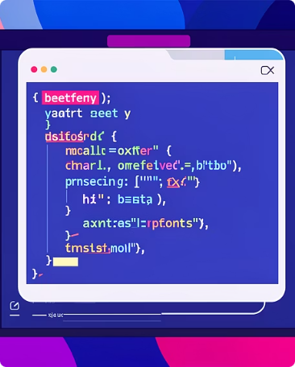
Working with CSV and JSON
CSV (csv module)
JSON (json module)
Use csv.reader/csv.DictReader for row-based parsing. Best for tabular data; watch delimiters and encoding.
Use json.load/json.dump for structured data exchange (APIs, configs). Handles nested dicts and lists natively.
Choose CSV for flat tables; JSON when structure matters. Always validate and handle encoding/edge cases.

Slide 9

Finally
Log and clean up
Process Data
Run when no error
Handle Errors
Catch specific exceptions
Try File
Open/read/write file
Use try/except/else/finally to handle errors predictably. Catch specific exceptions first, then fallback to general Exception only if necessary. Use raise to surface unexpected conditions.

Slide 10

Key Takeaways & Next Steps
Practice
File Exercises
Implement small classes, then extend with inheritance and overriding.
Read/write text, parse a CSV, and exchange JSON with a simple API call.
Error Handling
Write robust code using specific exceptions and context managers.
Recommended practice: build a small project that reads CSV data, models it with classes, and outputs JSON—this ties today's concepts together.

Slide 11
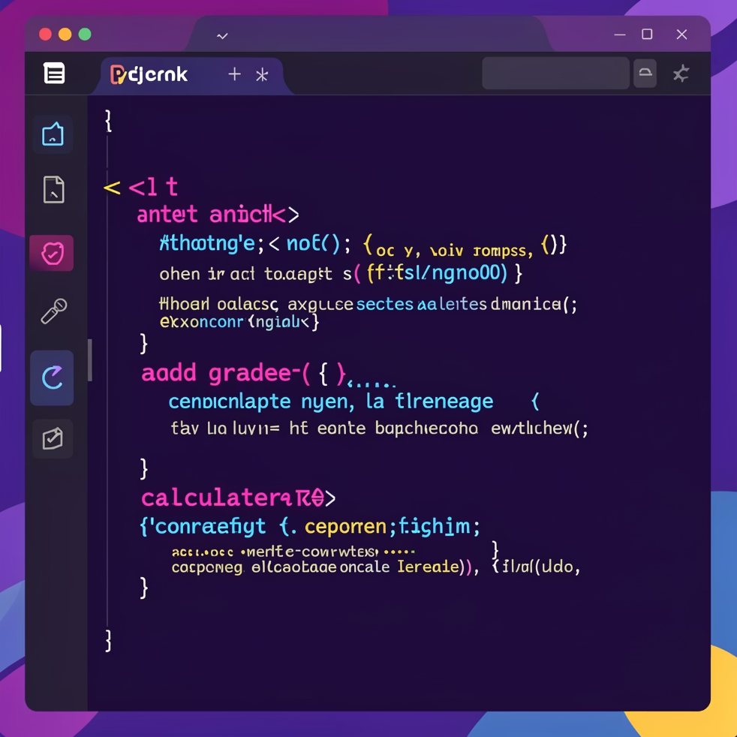
Practical Exercise: Building a Student Class
Let's put OOP concepts into practice! Your task is to build a Student class that can manage student information and grades.
Your Challenge:
Define a class named Student.
The constructor __init__ should take name and student_id. Initialize an empty list for grades.
Implement an add_grade(self, grade) method to add a new grade to the student's list.
Implement a calculate_average(self) method that returns the average of all grades, handling cases where there are no grades.
Create a few Student objects and test your methods!
Example Code Structure:
class Student:
def __init__(self, name, student_id):
self.name = name # Student's name
self.student_id = student_id # Unique identifier
self.grades = [] # List to store grades
def add_grade(self, grade):
"""Adds a new grade to the student's record."""
# Ensure the grade is a number before adding
if isinstance(grade, (int, float)):
self.grades.append(grade)
else:
print("Invalid grade type. Please provide a number.")
def calculate_average(self):
"""Calculates the average of the student's grades."""
if not self.grades:
return 0.0 # Return 0 if no grades
return sum(self.grades) / len(self.grades)
# Example Usage:
# student1 = Student("Alice", "S001")
# student1.add_grade(90)
# student1.add_grade(85)
# print(f"{student1.name}'s average: {student1.calculate_average()}")
This exercise reinforces class structure, instance attributes, and method implementation—core to Python OOP.

Slide 12

Real-World Pattern: Reading & Processing CSV Data
Let's bridge our OOP knowledge with file handling. This example demonstrates how to read student records from a CSV file, instantiate Student objects for each record, and handle potential file access errors. This is a common pattern in data-driven applications.
import csv
# Assuming the Student class is defined as in the previous exercise
# (e.g., from a module named 'student_data.py')
# class Student:
# def __init__(self, name, student_id):
# self.name = name
# self.student_id = student_id
# self.grades = []
# def add_grade(self, grade):
# if isinstance(grade, (int, float)):
# self.grades.append(grade)
# def calculate_average(self):
# return sum(self.grades) / len(self.grades) if self.grades else 0.0
def load_students_from_csv(filepath):
"""
Reads student data from a CSV file and returns a list of Student objects.
Assumes CSV has 'name', 'student_id', and optional 'gradeX' columns.
"""
students = []
try:
# Use a context manager to ensure the file is closed automatically
with open(filepath, mode='r', newline='', encoding='utf-8') as file:
# DictReader maps each row to a dictionary using header row as keys
reader = csv.DictReader(file)
for row in reader:
# Create a Student object for each row
name = row.get('name', 'Unknown') # Safely get name, default to 'Unknown'
student_id = row.get('student_id', 'N/A') # Safely get student_id
student = Student(name, student_id)
# Add grades if they exist in the CSV (e.g., 'grade_math', 'grade_science')
for key, value in row.items():
if 'grade' in key and value.replace('.', '', 1).isdigit(): # Check for 'grade' in key and if value is numeric
student.add_grade(float(value)) # Convert to float before adding
students.append(student)
return students
except FileNotFoundError:
print(f"Error: The file '{filepath}' was not found. Please check the path.")
return [] # Return empty list on error
except Exception as e:
print(f"An unexpected error occurred while processing '{filepath}': {e}")
return []
helps organize the parsed data effectively.

Slide 13


Common Pitfalls & Best Practices
Even experienced developers can stumble.

Slide 14



Slide 15
Common Pitfalls & Best Practices
Even experienced developers can stumble. Learn to recognize and avoid these common mistakes when working with OOP and file handling in Python.
Forgetting `self`
Not Closing Files
Problem: Instance methods fail to access attributes or other methods of the object, leading to NameError or incorrect behavior.
Problem: File handles remain open, consuming resources, potentially corrupting data, or preventing other programs from accessing the file.
Solution: Always include self as the first parameter in instance methods and use self.attribute or self.method() to interact with the object's components.
Solution: Use Python's with open(...) as file: construct. This context manager automatically handles closing the file, even if errors occur.
Mutable Default Arguments
Ignoring Exceptions
Problem: When a mutable object (like a list or dictionary) is used as a default argument, it's created only once. Subsequent calls to the function modify the same object, leading to unexpected shared state.
Problem: Programs crash unexpectedly when errors like FileNotFoundError, ValueError, or network issues occur, providing a poor user experience.
Solution: Implement robust try...except blocks to gracefully catch and handle anticipated errors, providing informative feedback or implementing recovery logic.
Solution: Use None as the default argument. Inside the function, check if the argument is None and, if so, initialize the mutable object (e.g., if my_list is None: my_list = []).

